Slide 1
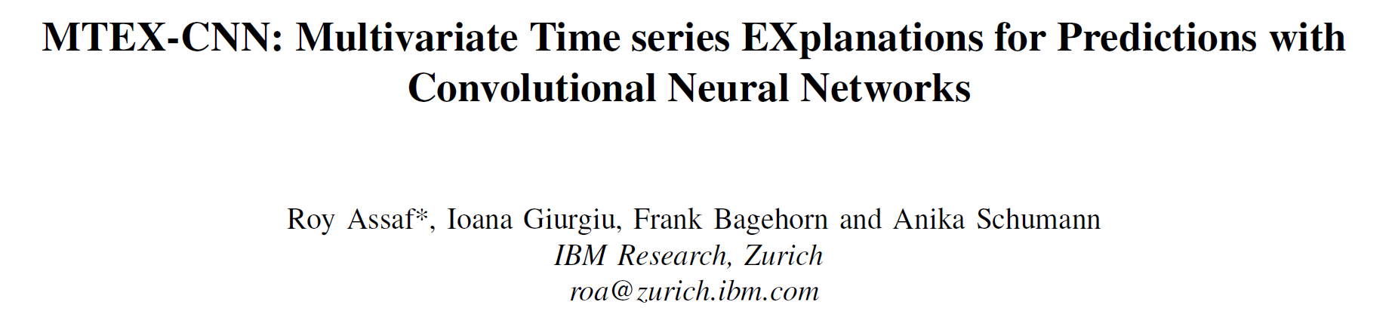

Slide 2
Outline
Introduction
MTEX-CNN
Gradient-based explanations
Experiments
Inspirations

Slide 3
Introduction
Goal: explanations for predictions
Feature: multivariate time series
Model: Convolutional Neural Networks
Contributions:
CNN architecture + gradient-based explainability method
Experiments on two use cases
Retraining with significant features

Slide 4
MTEX-CNN
Input: N×T matrix (N – time series, T – features)
CNN architecture: 2 stages
Stage 1
Stacked 2D convolution layers: extract the feature attention on time dimension
One 1×1 convolution layer: compress feature maps
Stage 2
Stacked 1D convolution layers: account for the interaction between different TS
Tow dense layers: output

Slide 5
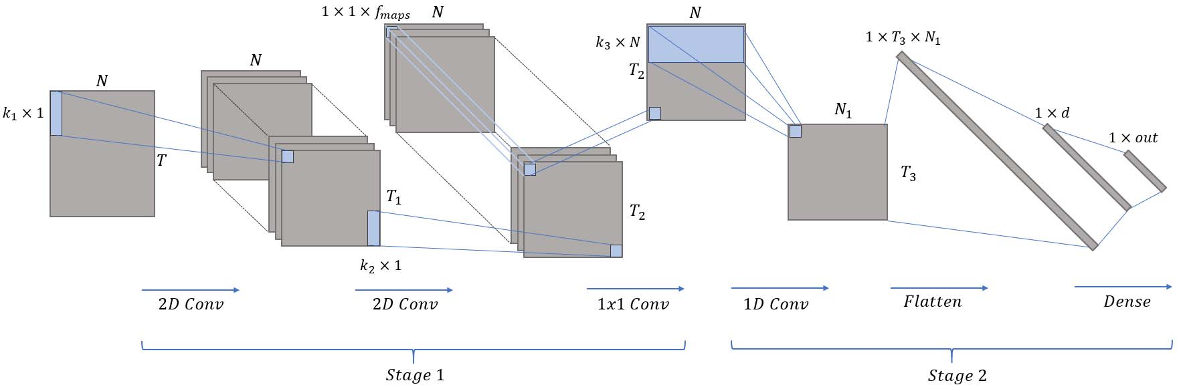
MTEX-CNN
An example for the use cases
Two 2D Conv + One 1×1 Conv + One 1D Conv + Two Dense

Slide 6
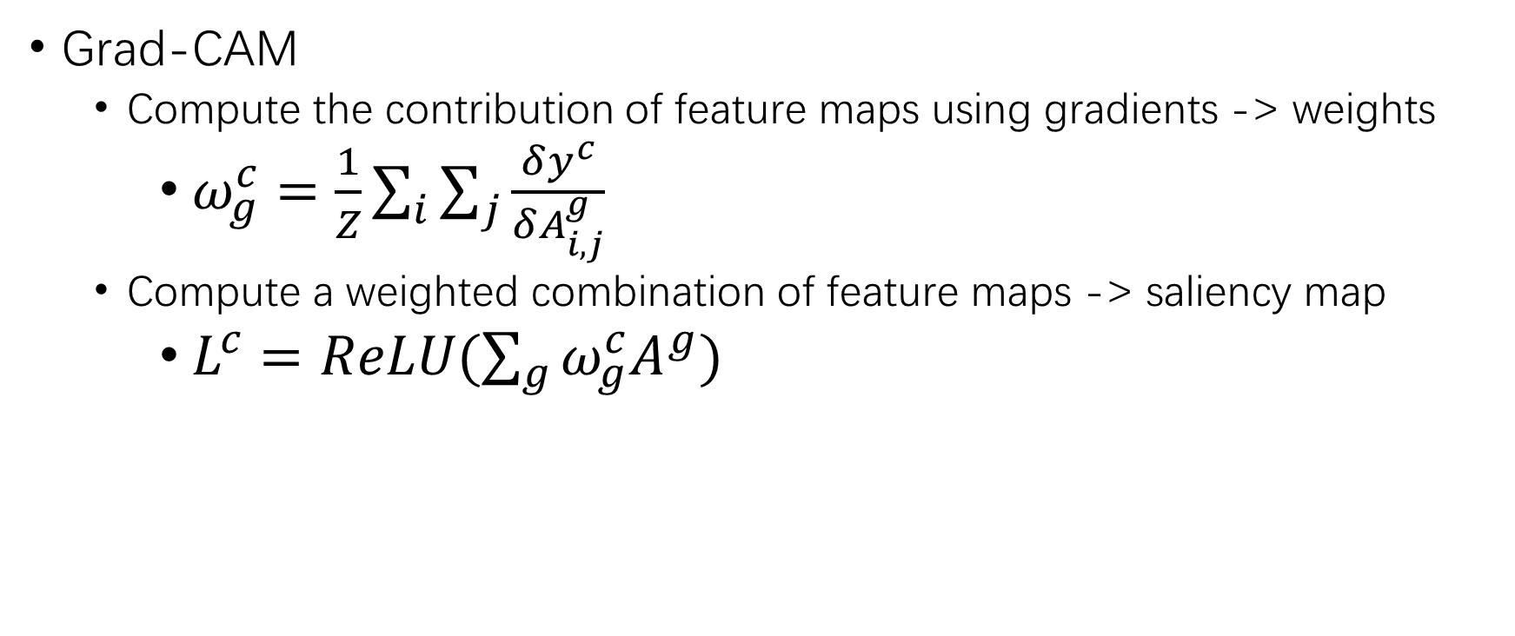
Gradient-based explanations
Grad-CAM
Compute the contribution of feature maps using gradients -> weights
$ω_{g}^{c}=\frac{1}{Z}\sum_{i}{\sum_{j}{\frac{δy^{c}}{δA_{i,j}^{g}}}}$
Compute a weighted combination of feature maps -> saliency map
$L^{c}=ReLU(\sum_{g}{ω_{g}^{c}A^{g}})$

Slide 7
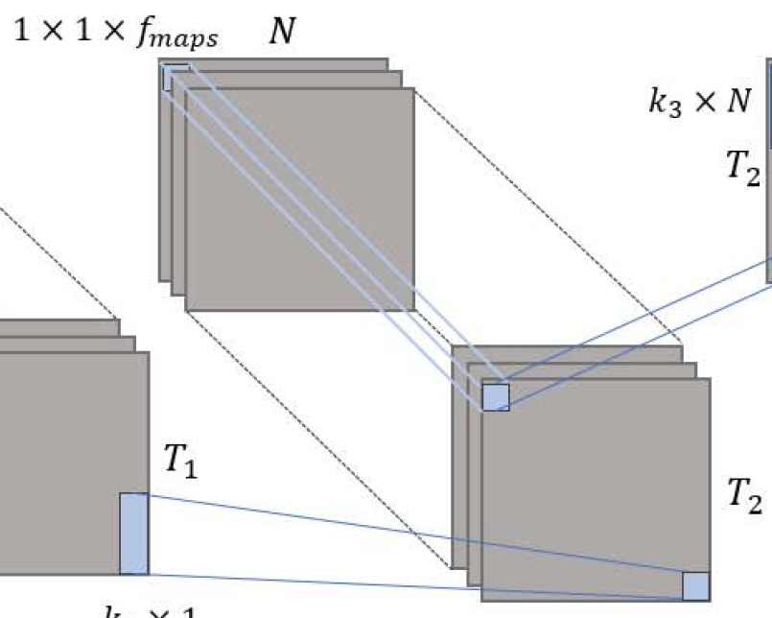
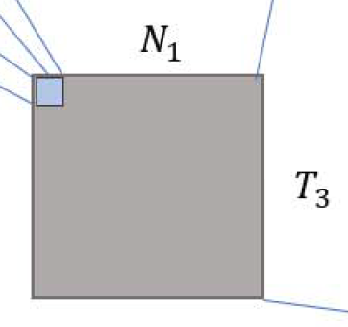
Gradient-based explanations
Apply Grad-CAM to:
the last 2D Conv layer in stage 1
Highlight the contribution of time dynamics
Explain significant features
1D Conv layer in stage 2
Highlight the contribution of features
Explain significant time segments
feature map
feature map

Slide 8
Experiments
Two use cases
A benchmark used to predict the average energy production of photovoltaic power plants (光伏电站)
A real-world scenario for predicting rare server outages
CNN model
Stage | Stage 1 |  |  | Stage 2
Layer | 2D Conv | 2D Conv | 1×1 Conv | 1D Conv | Dense | Dense
Kernel size | (8, 1) | (6, 1) |  | (4)
Padding | Half padding |  |  | Half padding
Stride | (2, 1) | (2, 1) |  | (2)
Activation | ReLU |  |  | ReLU
Dropout | 0.4 |  |  | 0.4
Length |  |  |  |  | 128 | output

Slide 9
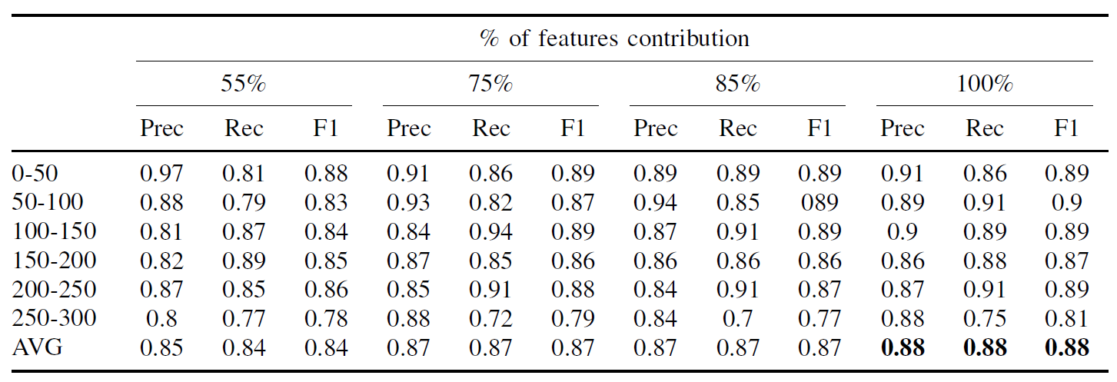
Experiments – Use Case #1
Setup
Features: 7 weather-related features + 2 sensor features
Time series: hourly aggregated features for 4 days
Labels: 6 classes (0-300 kW)
Results

Slide 10
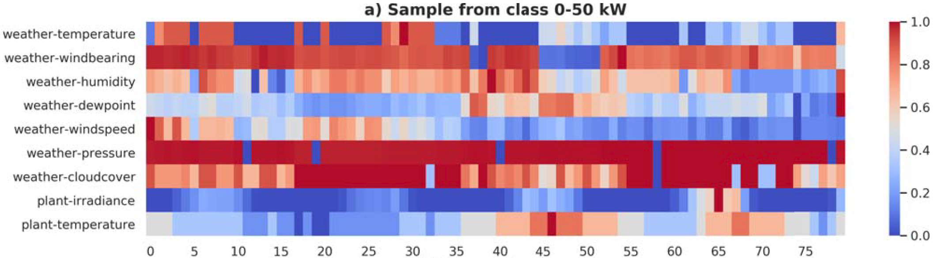
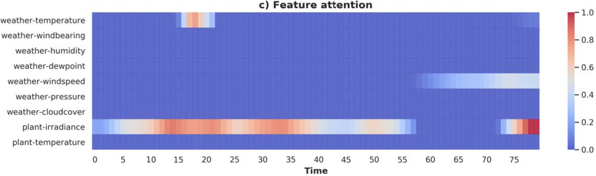
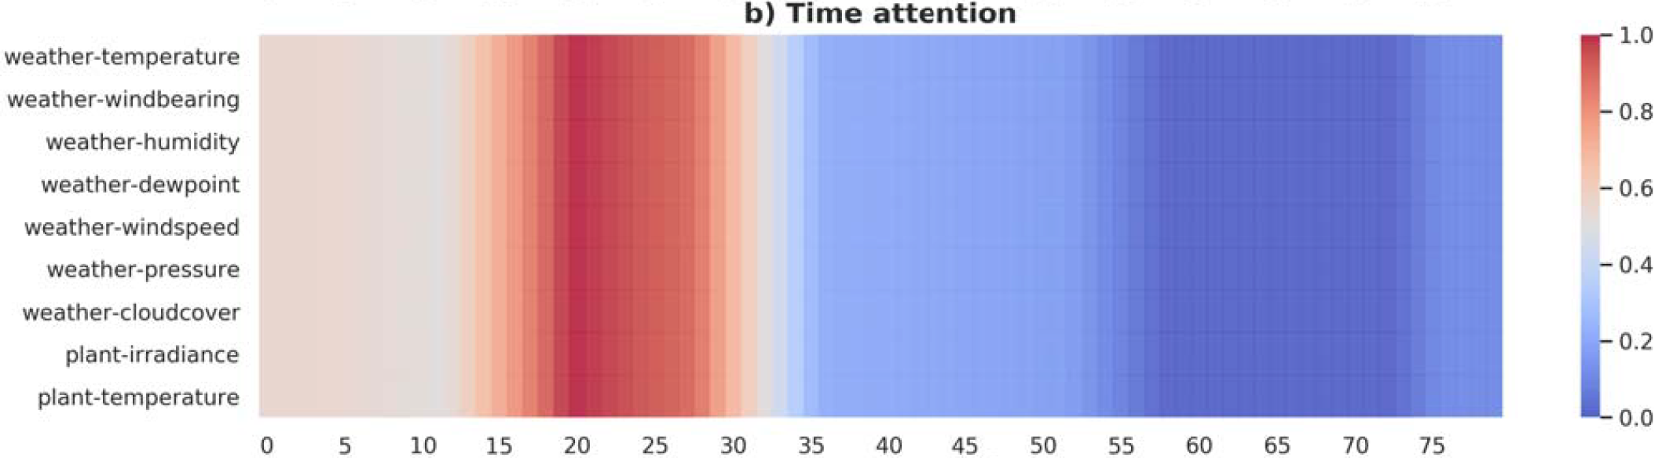
Experiments – Use Case #1
Explanations

Slide 11
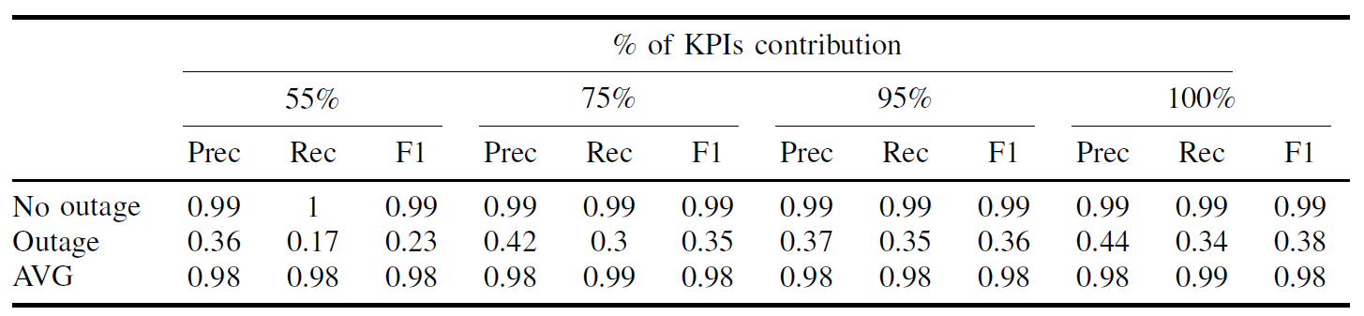
Experiments – Use Case #2
Setup
Features: 47 KPIs
Time series: 15-minute aggregated features for 216 time steps (2d 6h)
Labels: 2 classes (outage or not)
Results

Slide 12
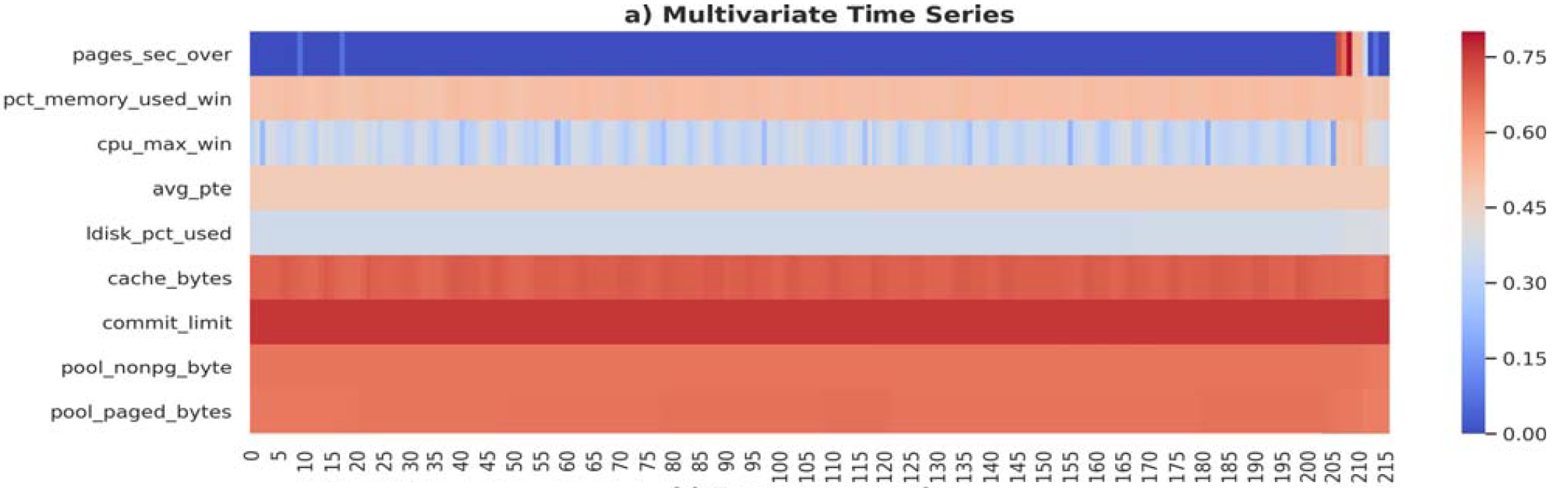
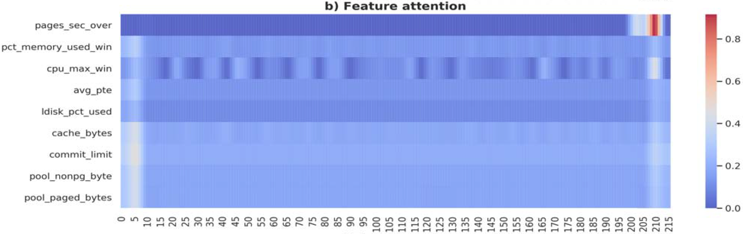
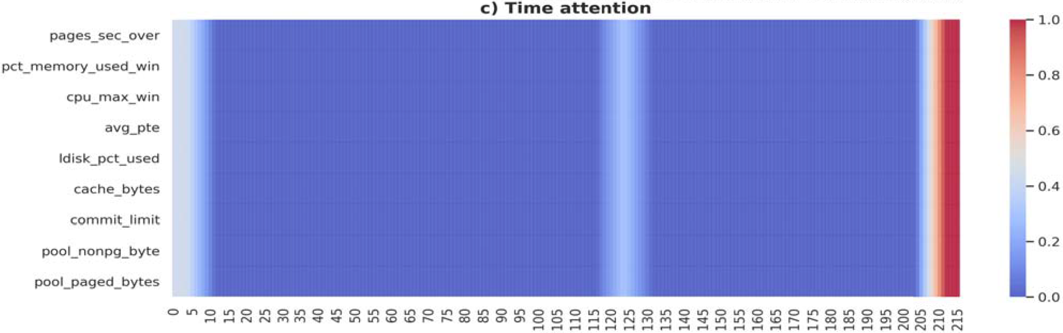
Experiments – Use Case #2
Explanations – True Positive

Slide 13
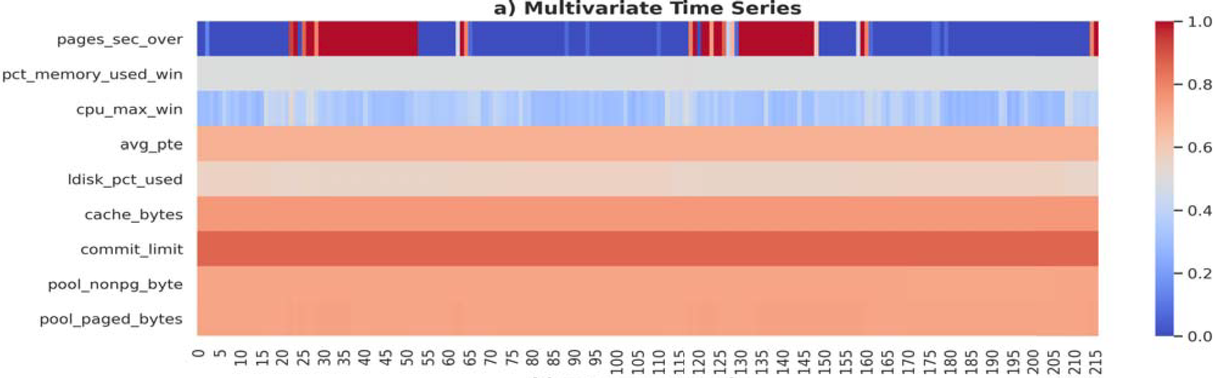
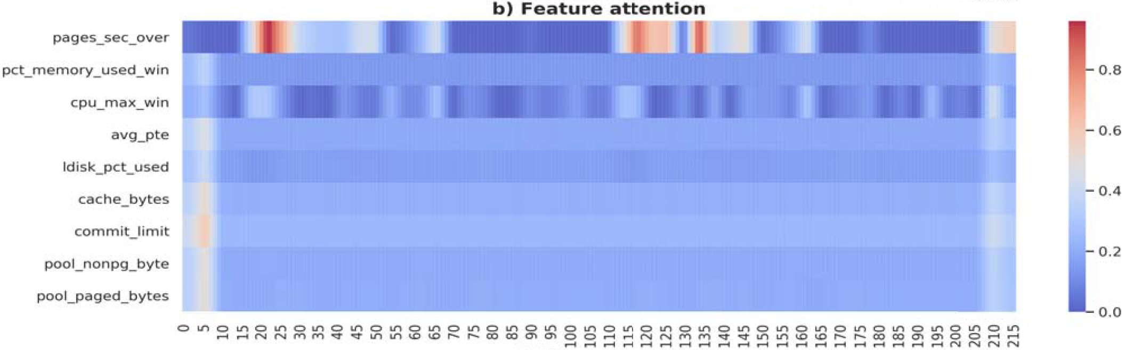
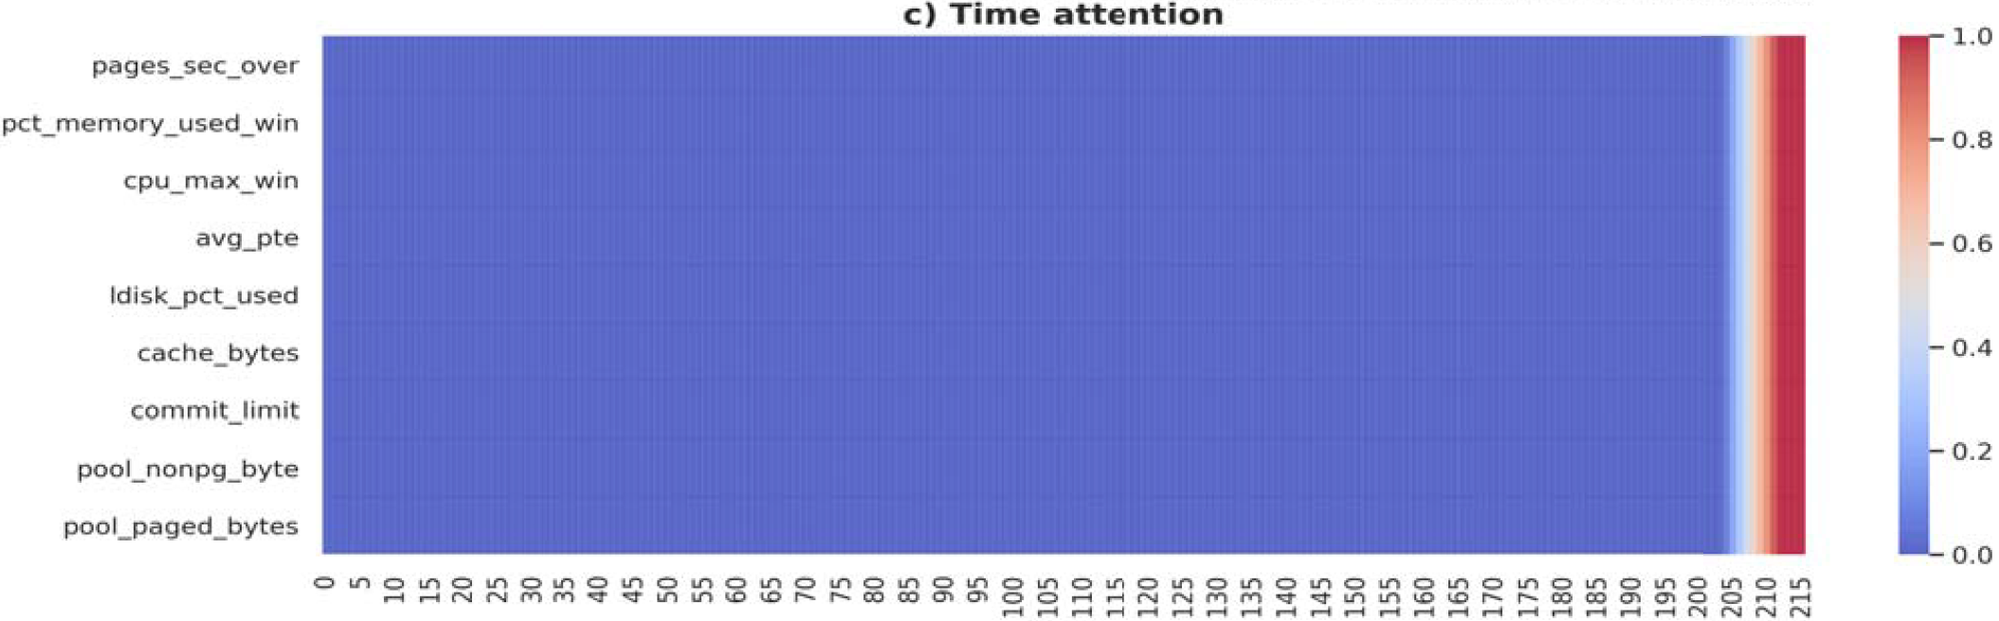
Experiments – Use Case #2
Explanations – False Positive

Slide 14
Inspirations
CNN for time-series prediction
2-stage CNN architecture
Visualization for explanation (saliency map)
The use case about server outage

